Slide 1
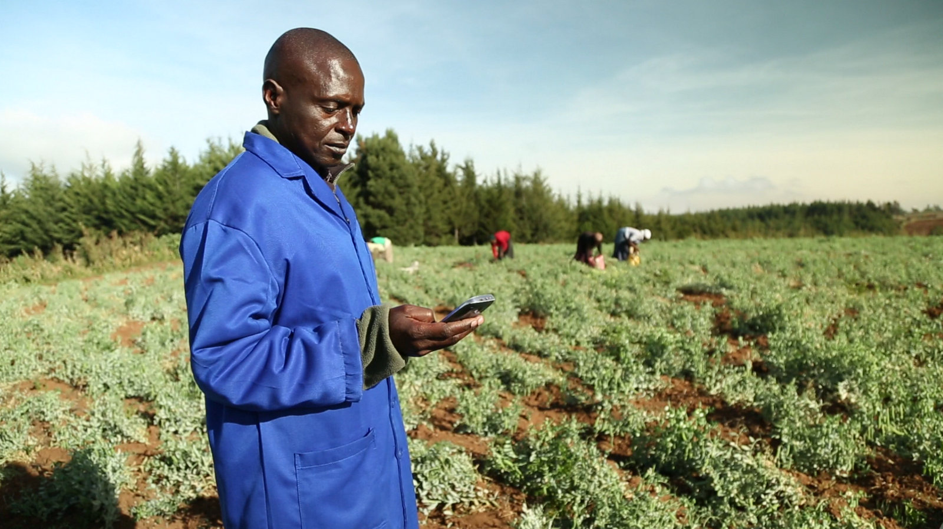
Group 1
AgriTrader
The Team
1. Kevin Wahome - Software Developer
2. Viscount Wathika - Software Developer
3. Mr. Peter Kuria - Program Officer
4. Frank Chege - Monitoring and Evaluation Officer
5. Daisy Rono - Monitoring and Evaluation Officer

Slide 2
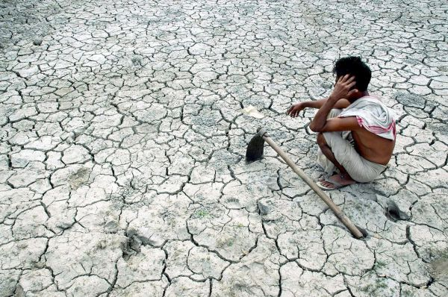
The Problem
Majority of small scale farmers lack access to variety of markets
Vulnerable to exploitation of the brokers/middle men… Low prices for commodities.
Most farmers do not know their cost of production
Difficult to determine their break even points.

Slide 3
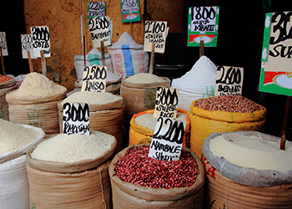
Market Description
Small holder farmers with diverse enterprise (mixture of livestock and crops)
Middlemen/aggregators dealing with agricultural products.

Slide 4

Solution description
AgriTrader links farmers and traders
Farmers can log and track cost of production for different enterprises
Farmers can place offers for produce on sale and receive bids.
Aggregators/Middlemen can make bids for produce on offer.
Farmers accept bids based on Break even points determined by cost of production and prevailing market rates.

Slide 5
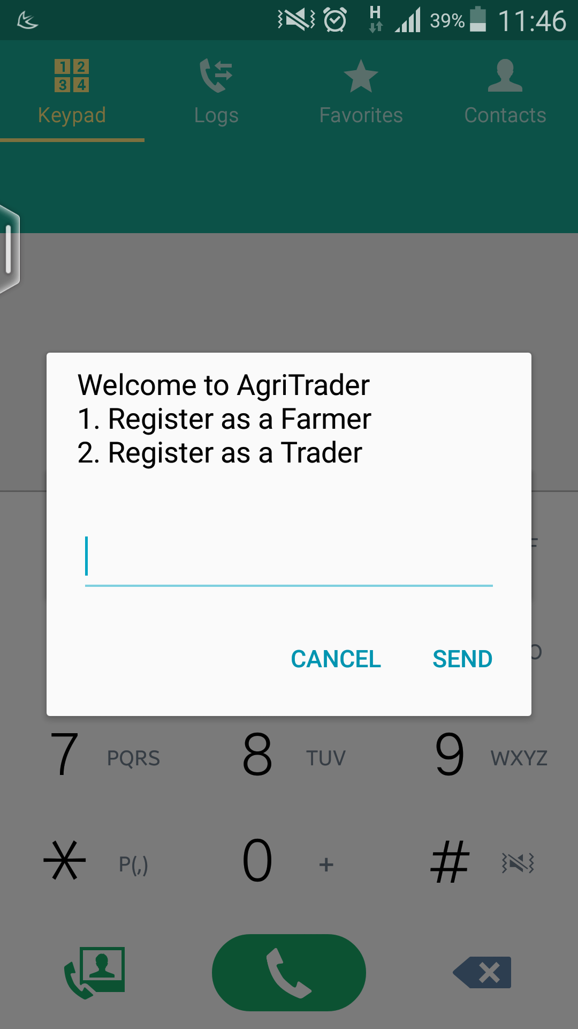
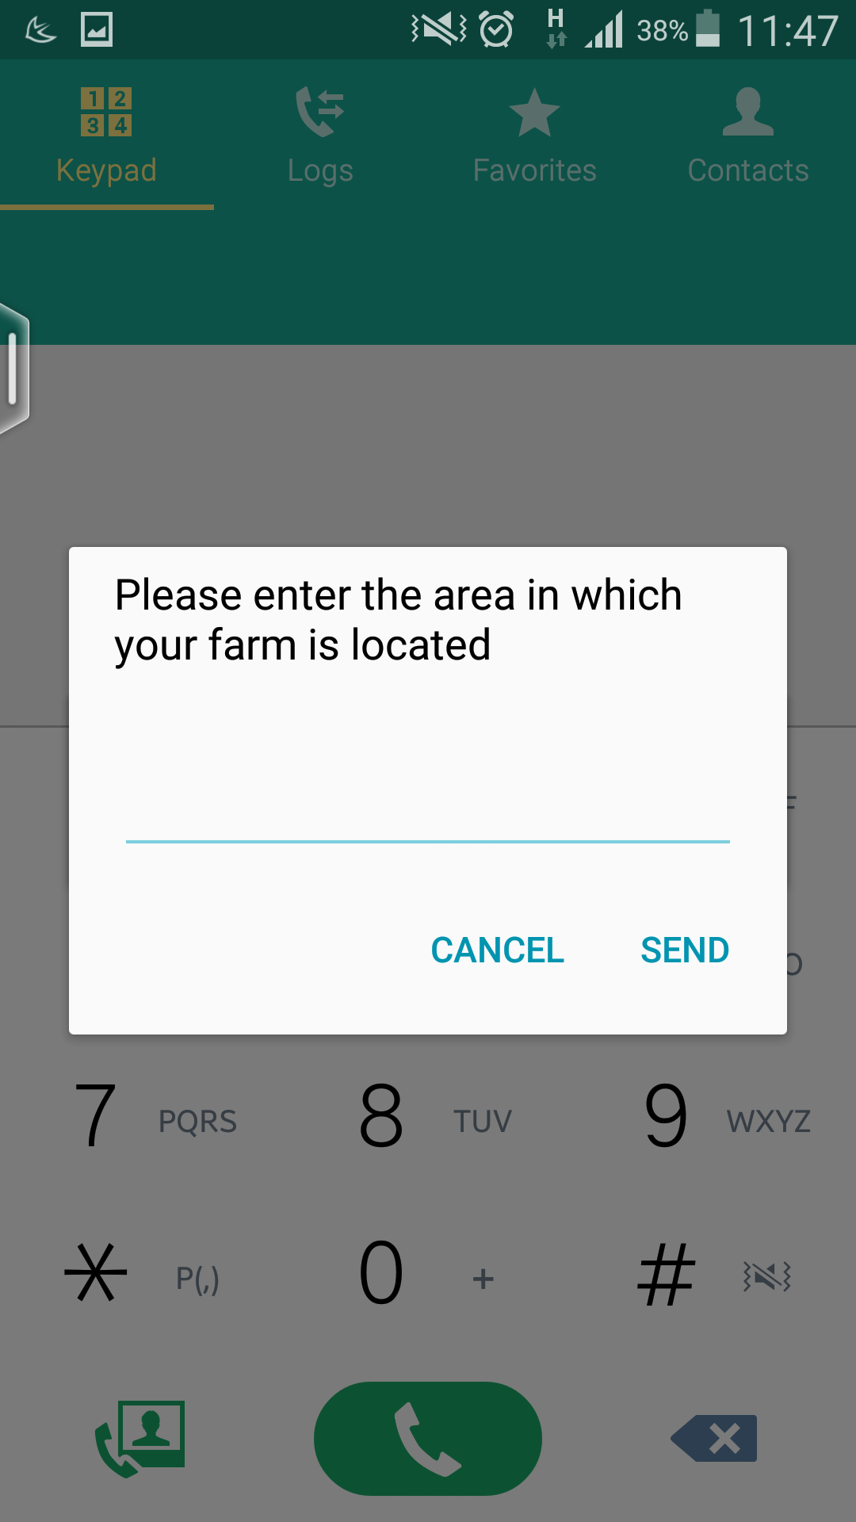
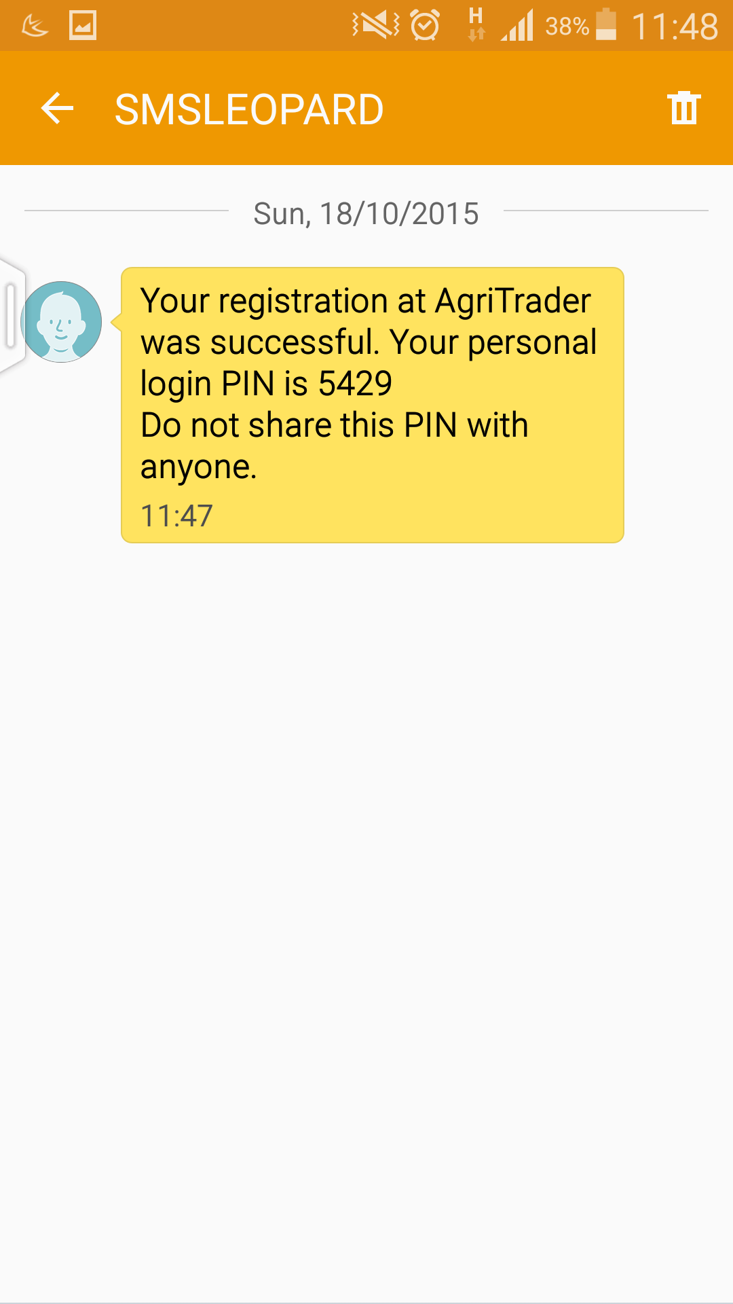
Screenshots – USSD (*384*95#)

Slide 6
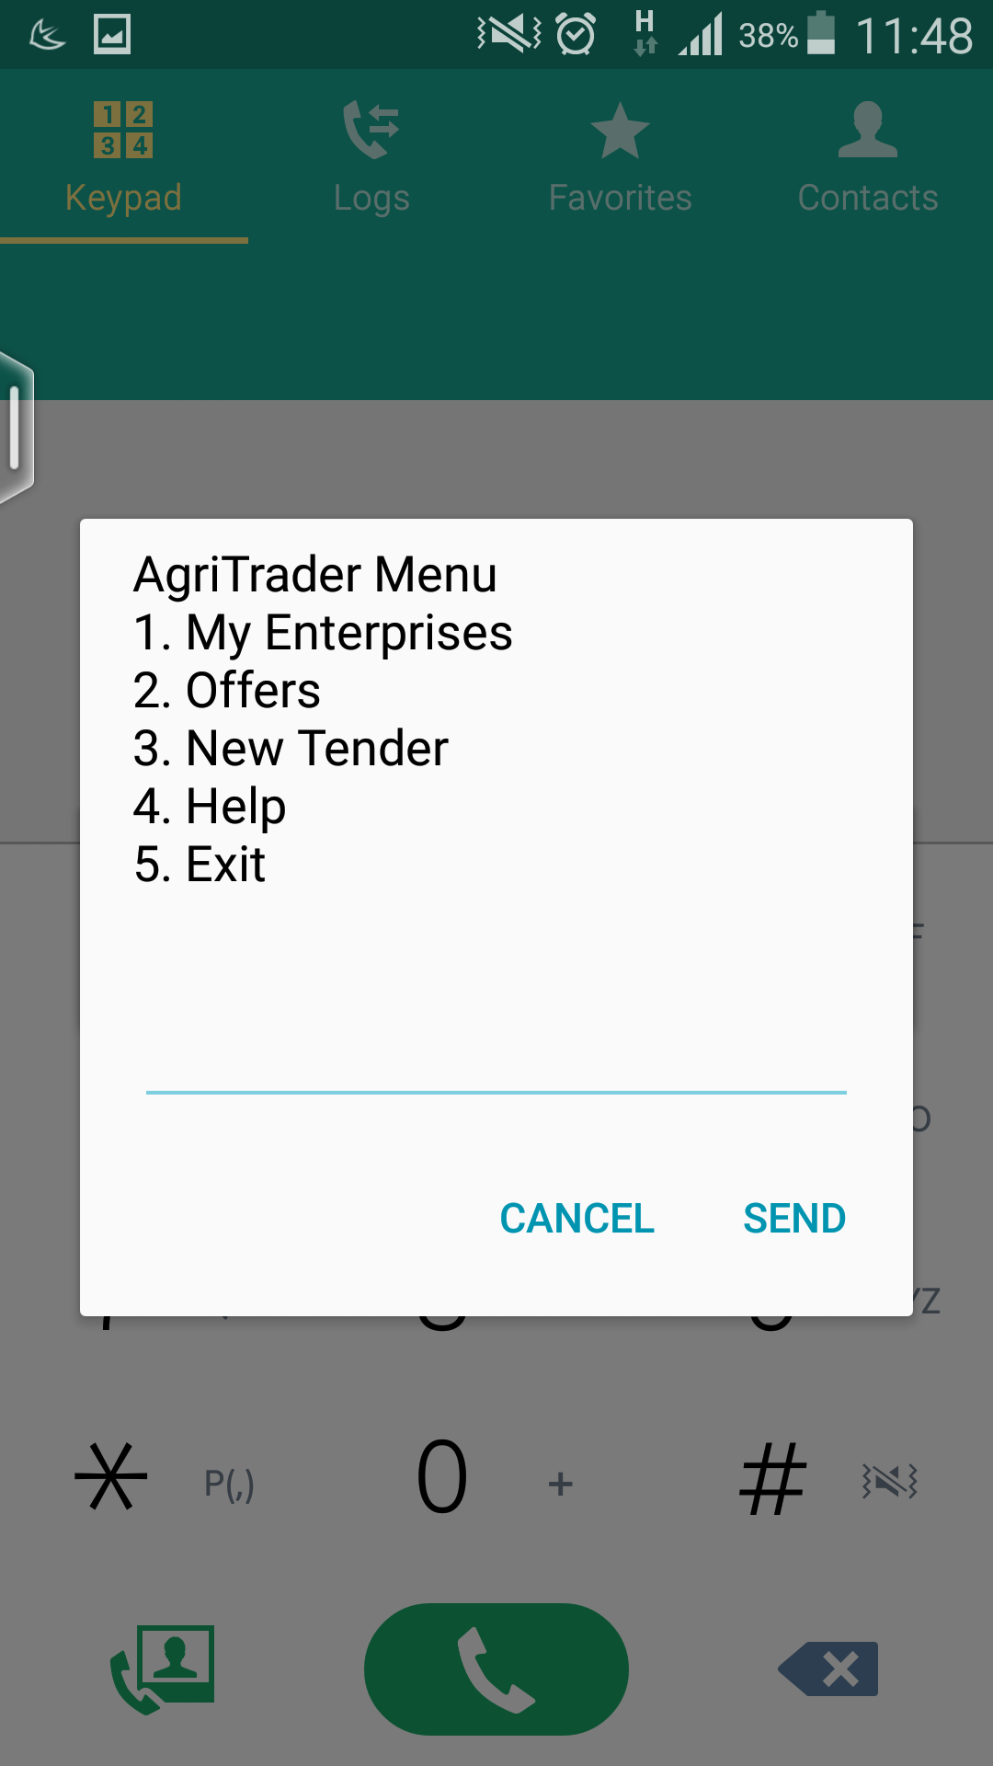
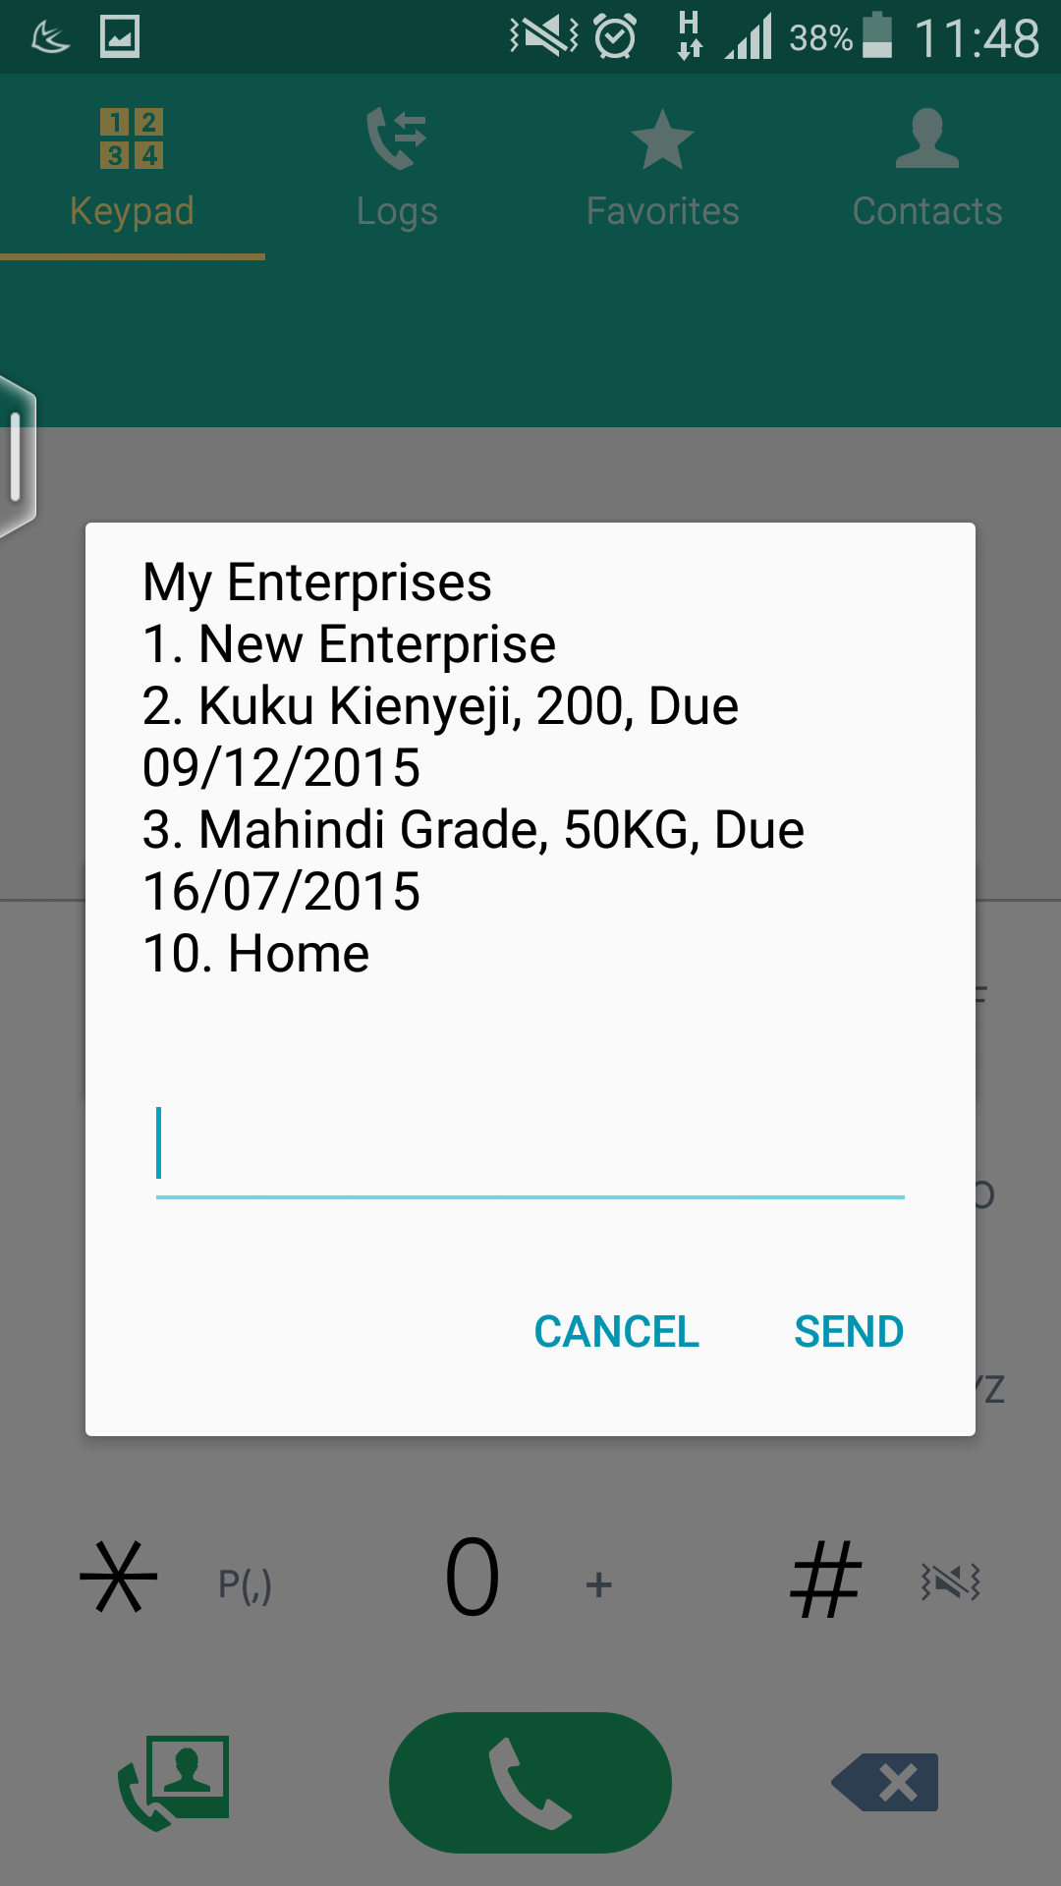
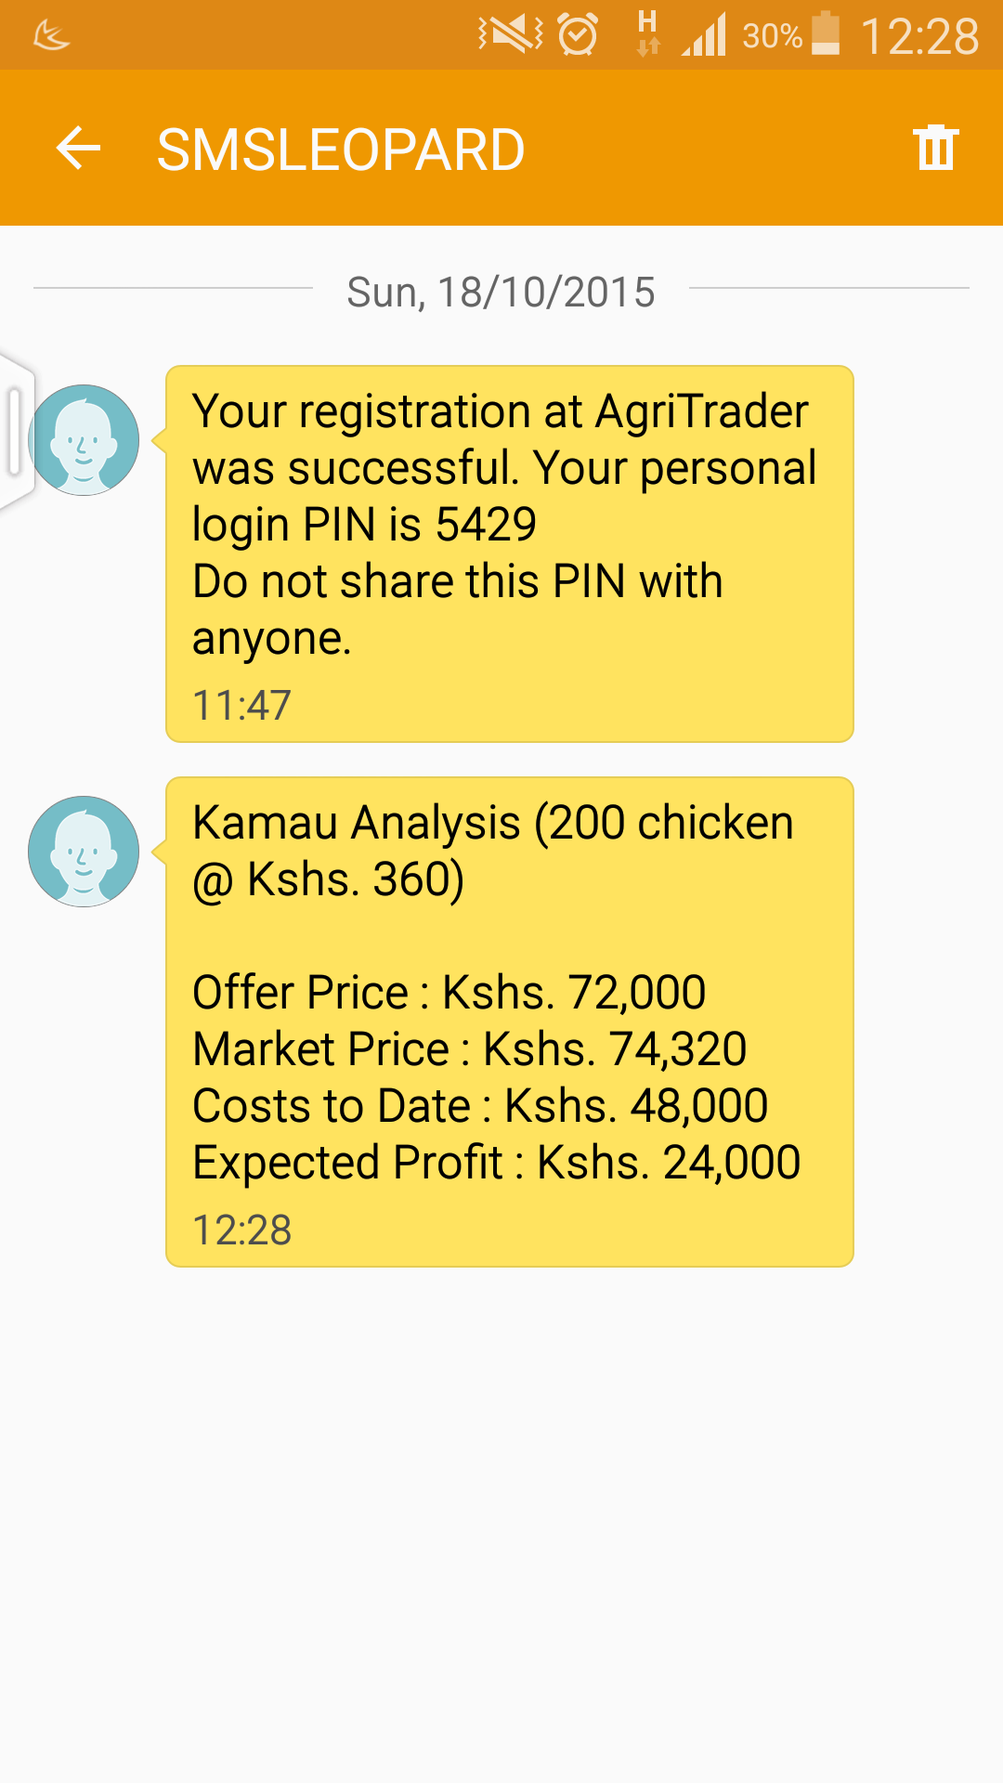
Screenshots – USSD (*384*95#)

Slide 7
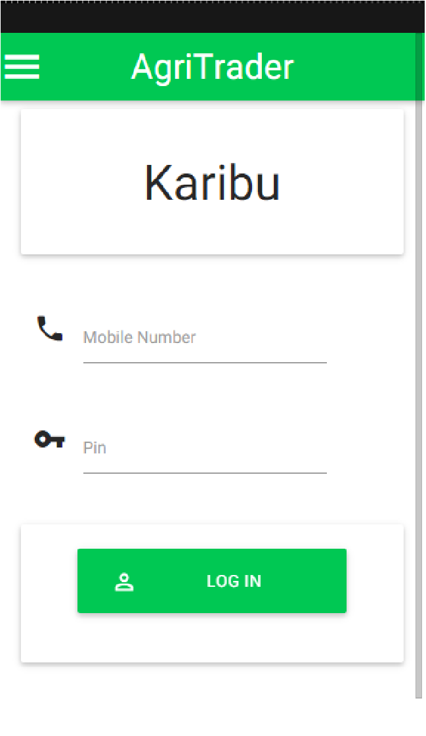
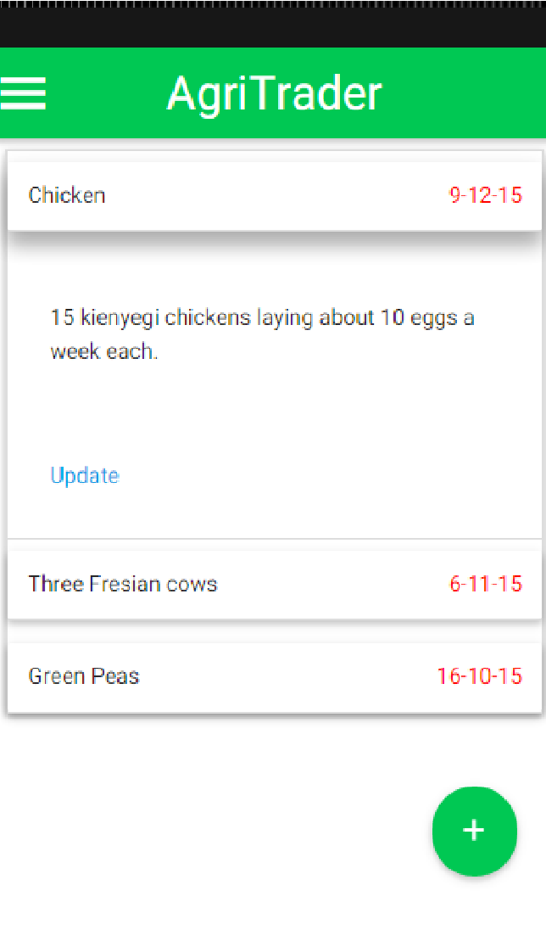
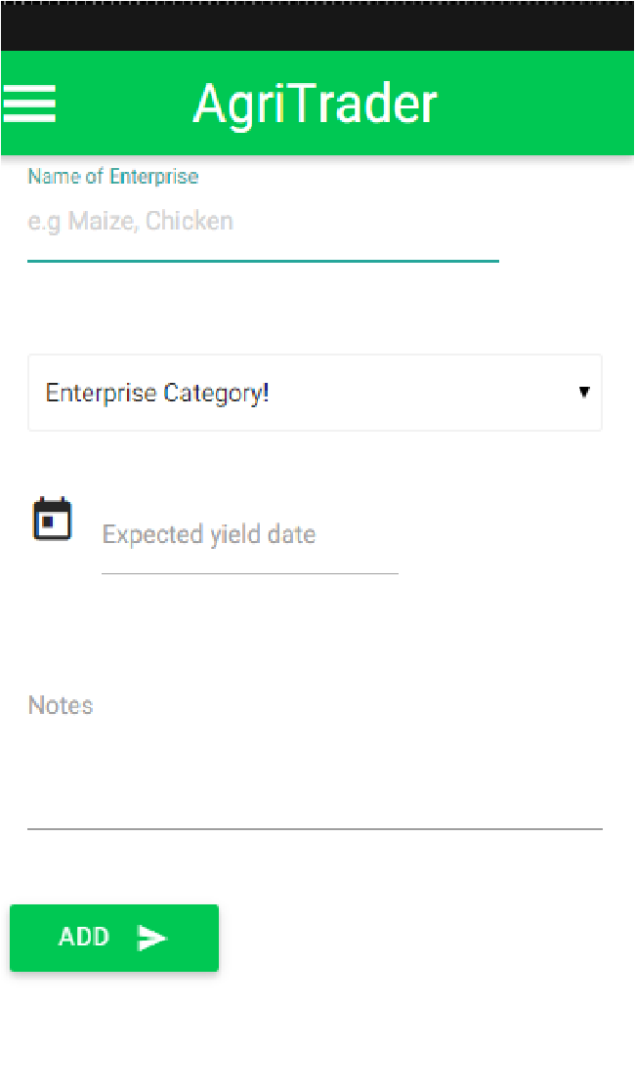
Screenshots – Mobile APP

Slide 8
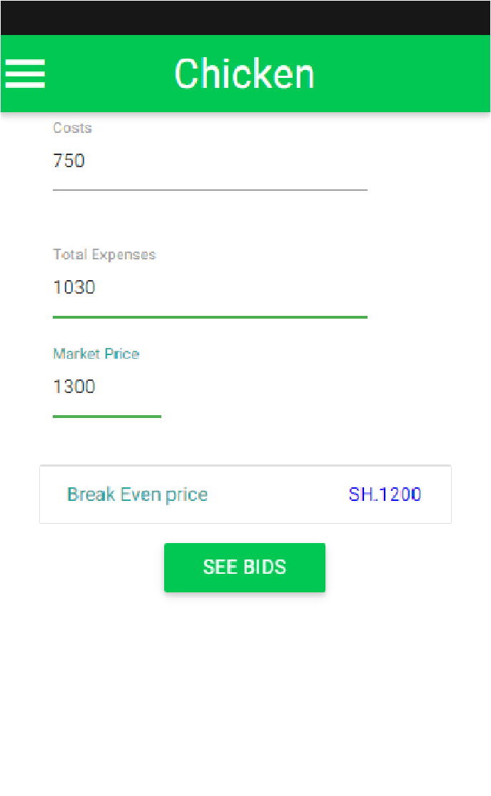
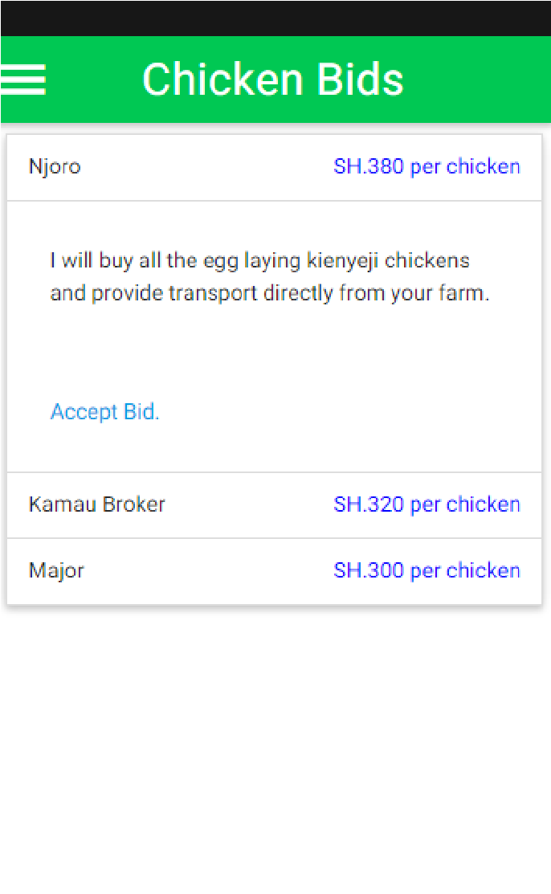
Screenshots – Mobile APP

Slide 9

Impact?
Farmers able to track costs.
Farmers are able to understand the concept of breaking even.
Transactions are made through competitive bids and offers
Farmer maximises income.

Slide 10

Innovation?
Enabling the farmer to log and track the cost of production.
Transactions are made through competitive bids and offers
System prioritizes according to price.
The farmer is able to match their harvesting with market demands.
Farmers gets detailed and informed analysis of offers via SMS.
Traders access customised pool of producers from mobile phone effectively.

Slide 11

Technological Achievement?
Streamline the trader and farmer relationship i.e. automating the relationship
Cost of production tracking made easier.
Diversifying market access options.
Bring more brokers and middlemen into the picture with an aim of reducing monopoly
Challenges associated to storage and storage losses.

Slide 12

Revenue Model – Farmer Stream
The farmers register on the portal for free.
Farmer pays subsidised monthly subscription to use the service.
Farmers get a Paybill number for receiving payments.

Slide 13
Revenue Model – Trader Stream
Traders pay Registration Fee to access numerous tenders on system.
Each trader is charged a fixed rate(% of the total value) for every successful transaction.

Slide 14
Revenue Model – Other Stakeholders
The platform can be used to generate a database of farmers (and traders) with details such as location, farming enterprise, production levels, acreage which can be availed to interested parties at a cost.

Slide 15
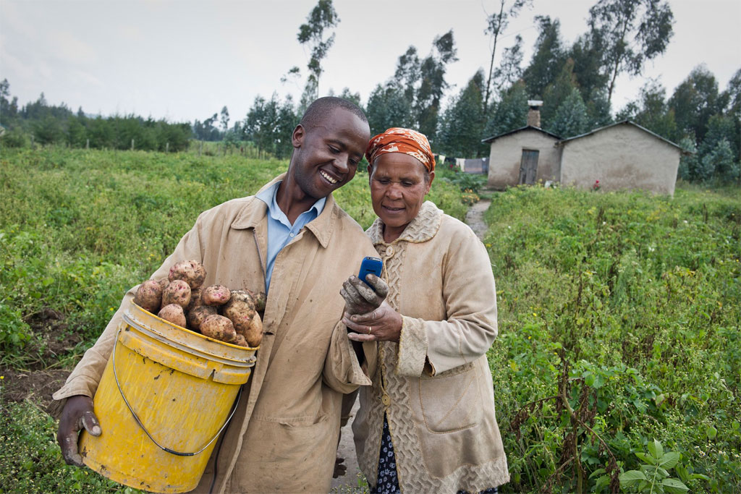
Q & A
Thank you ☺

